Slide 1
The Turkish Labor Market: A Few Facts and Figures
Prakash Loungani
Advisor, Research Department, IMF
April 22, 2013
I thank Ezgi Ozturk for excellent research assistance.
The views expressed in this presentation are those of the author and should not be attributed to the IMF.

Slide 2
Outline of talk
Turkish labor market performance during the global financial crisis
A broader look
Beveridge Curve
Okun’s Law
Medium-term: challenges and opportunities

Slide 3
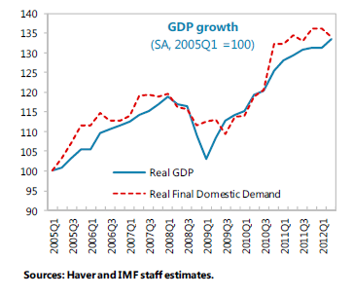
Recovery from the crisis

Slide 4
Output and unemployment during the crisis
Source: Hakan Ercan (2012)

Slide 5
Unemployment by duration

Slide 6
Share of long-term unemployment

Slide 7
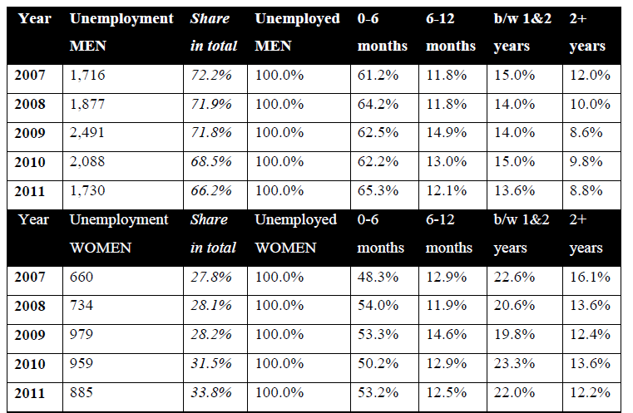
Unemployment by gender

Slide 8
A broader look: unemployment and vacancies

Slide 9
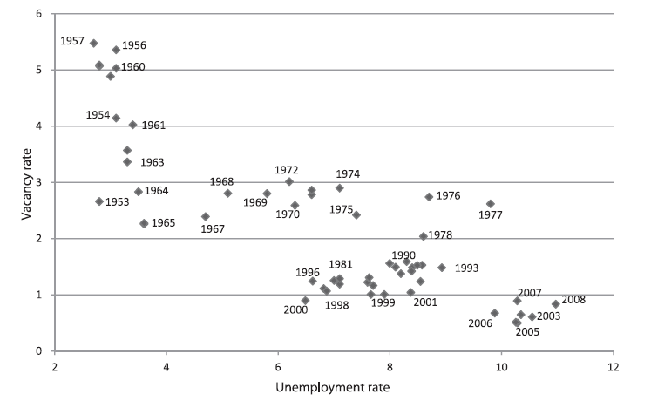
Beveridge Curve for Turkey

Slide 10
Okun’s Law in Turkey 1989-2012

Slide 11
Okun’s Law in Turkey: Age Group of 35-44 1989-2012

Slide 12
Okun’s Law in Turkey: Age Group of 45-54 1989-2012

Slide 13
Okun’s Law Coefficients: OECD Countries 1978-2011

Slide 14
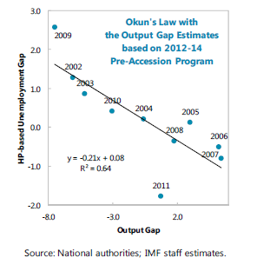
Okun’s Law during the Crisis

Slide 15
Medium-term: IMF advice on avoiding boom-bust cycles
Due to its low savings, Turkey remains prone to boom-bust cycles driven by capital flows.
Fiscal policy has a role to play in raising national savings and mitigating the economy’s excessive cyclical swings.
Contain real primary spending growth below the potential growth rate of 4 percent in the next three years and change the public pension system; in particular, by increasing contribution rates without raising benefits
public spending on health programs, which has grown significantly in recent years, could be reexamined;
tax base should be broadened by eliminating tax exemptions and improving tax administration.
Recent reforms to boost private savings

Slide 16
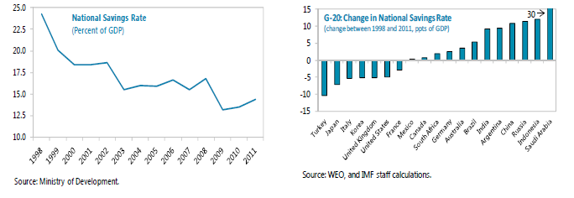
Savings Rate in Turkey

Slide 17
IMF advice on supporting domestic saving
Boosting competitiveness more broadly would support domestic saving.
The recently introduced Commercial Code helps improve corporate governance and encourages FDI.
The recent package of investment incentives could, if properly administered, help stimulate investment in advanced technology sectors and lower the import content of production.
But past experience with similar schemes, depending on tax exemptions, showed mixed results. Thus, expectations should be modest and higher priority should be given to maintaining broad VAT and income tax bases.

Slide 18
IMF advice on labor market reforms
Efforts to address the large informal sector, which have had some success in recent years, need to be sustained.
Evidence suggests firms in informal sector more liquidity constrained, invest less, are less profitable, and grow more slowly than in formal sector.
Informal workers save less than their counterparts in the formal sector.
The labor market needs to become more competitive
greater use of part-time and temporary labor
reform of the severance pay system, and slowing the growth of the high minimum wage, while ensuring an adequate safety net.
Continue improving the quality of its workforce by bolstering the education system and training programs.
Measures to boost the female participation rate, which at about 30 percent remains well below that of most middle-income countries.

Slide 19
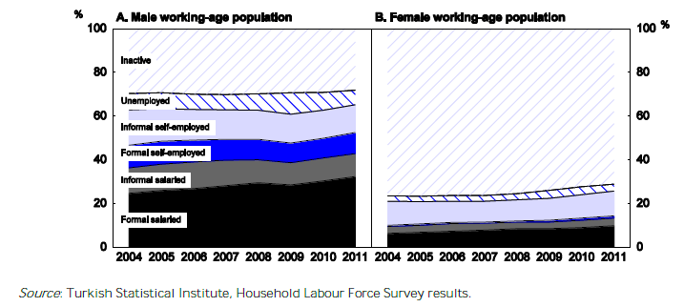

Slide 20
OECD advice

Slide 21
Thank you

Slide 22
Additional slides on Okun’s Law

Slide 23
Okun’s Law in Turkey: Age Group of 15-24 1989-2012

Slide 24
Okun’s Law in Turkey: Age Group of 25-34 1989-2012

Slide 25
Okun’s Law in Turkey: Age Group of 55-64 1989-2012

Slide 26
Okun’s Law Coefficients: Emerging Market Countries 1978-2011

Slide 27
Okun’s Law Coefficients: Emerging European Countries 1978-2011

Slide 28
Okun’s Law Coefficients: MENA Countries 1978-2011

Slide 29
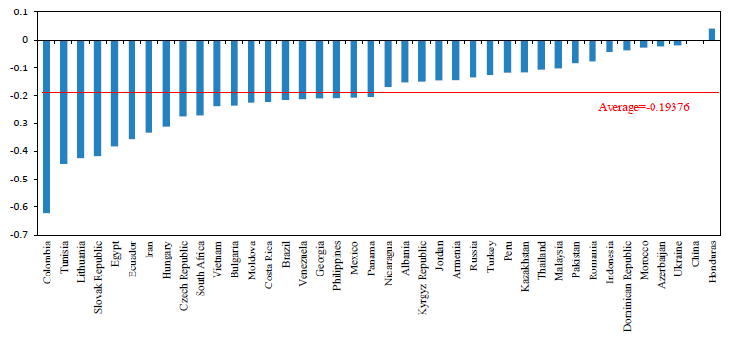
Okun’s Law: Countries with Comparable Data Quality

Slide 30
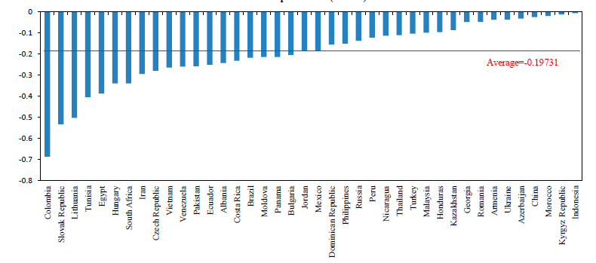
Okun’s Law: Countries with Comparable Data Quality

Slide 31
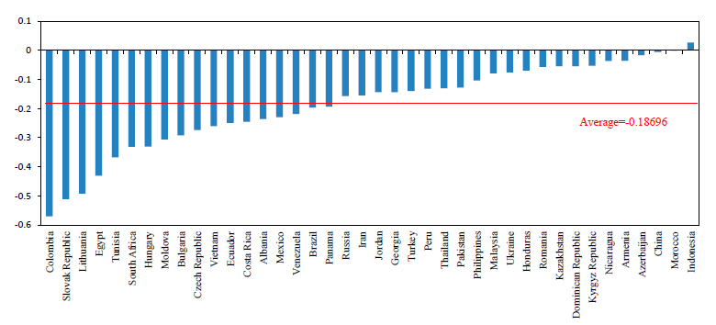
Okun’s Law: Countries with Comparable Data Quality

Slide 32
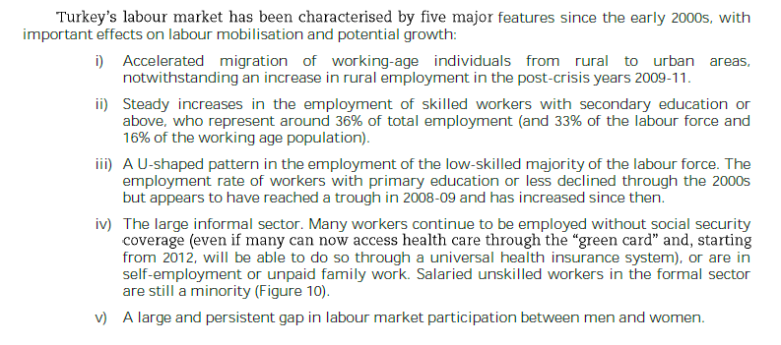
OECD on Turkish labor market

Slide 33
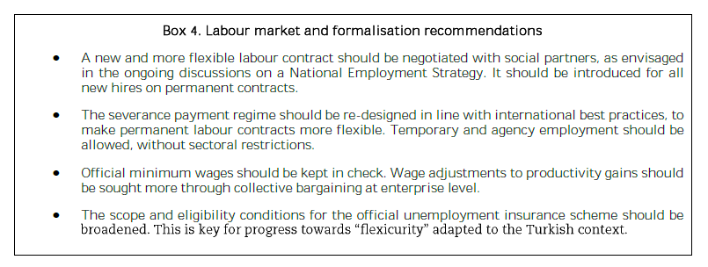
More on OECD advice on labor markets

Slide 34
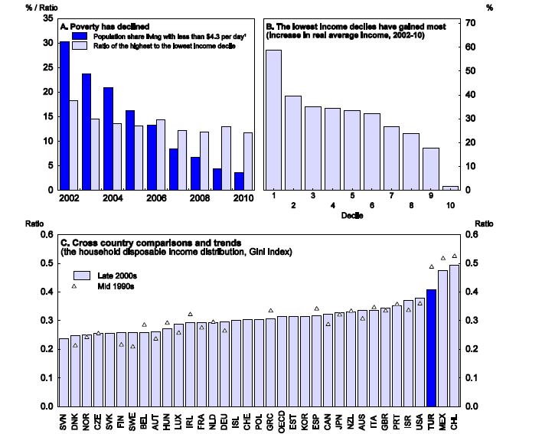
Turkey: Poverty and Inequality

