Slide 1
Turkey on the way to high income
Martin Raiser
Country Director
World Bank

Slide 2
Key Messages
Turkey has done well in the past decade
Due to demographics, past reform efforts and relatively strong financial buffers Turkey is likely to do well in the next decade
To avoid a growth slow-down at high income, Turkey needs to deepen structural reforms

Slide 3
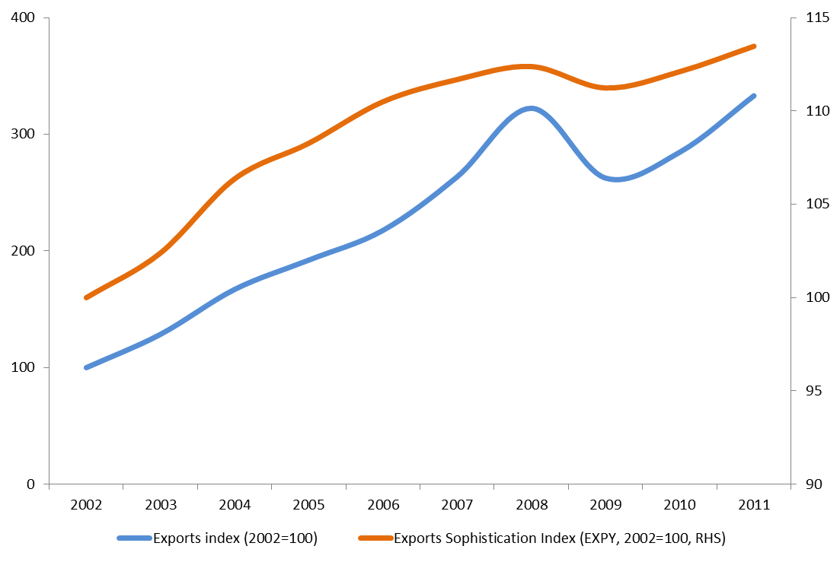
Turkey has done well because of economic integration

Slide 4
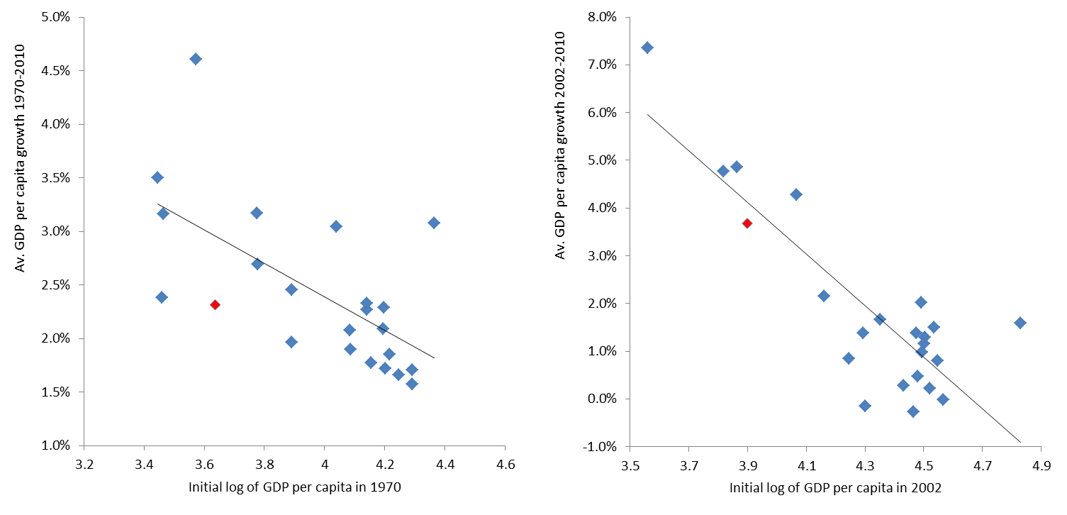
Turkey has become part of the European Convergence Machine

Slide 5
The Customs Union with the EU has made Turkish trade brainier

Slide 6
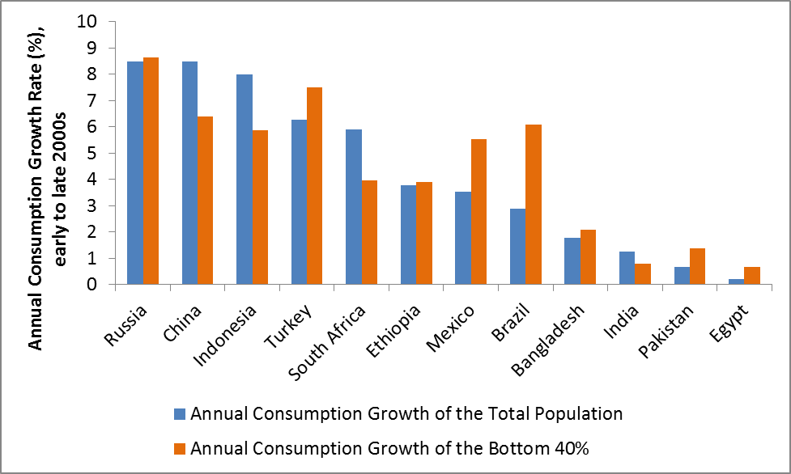
Turkey has done well because of social inclusion

Slide 7
The shift of economic activity to the East has played a big role in inclusion
Spatial distribution of newly created firms between 2007-2011

Slide 8
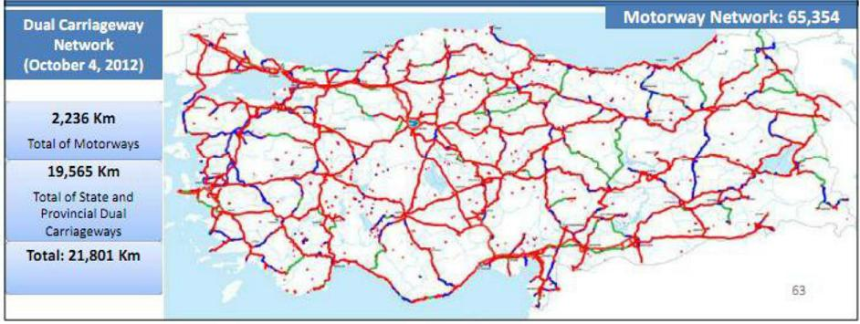
Supported by public investments

Slide 9
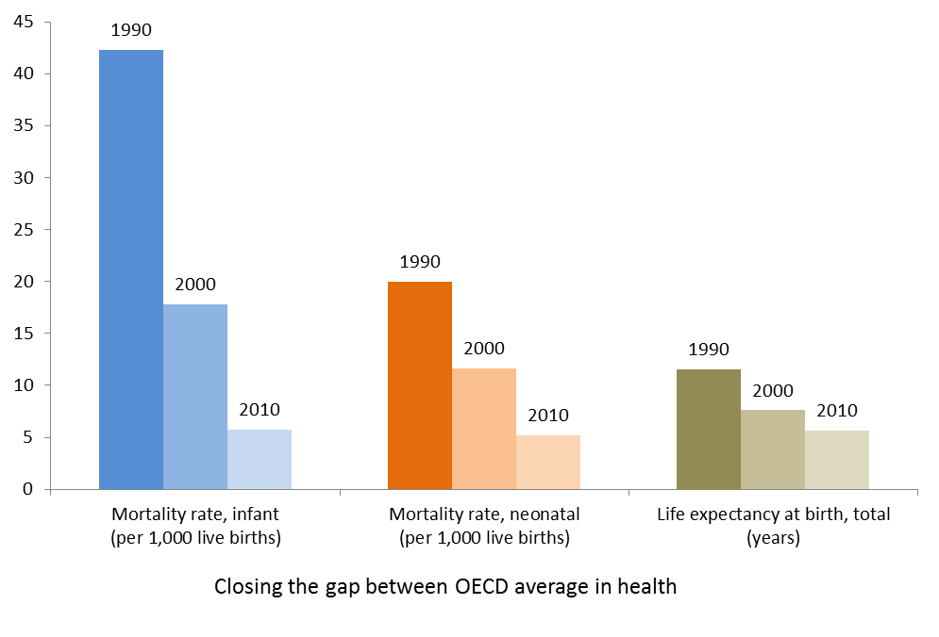
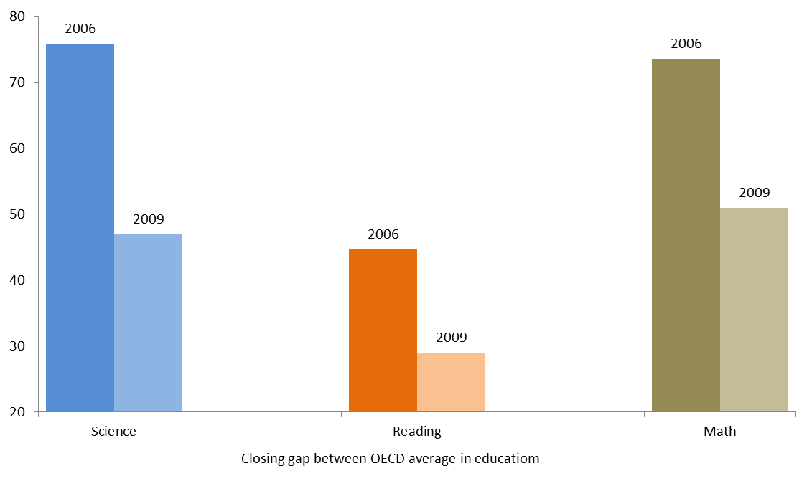
And improved public services

Slide 10
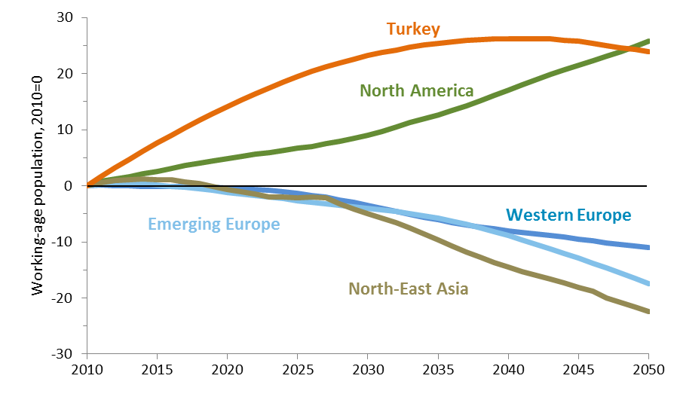
Turkey’s prospects are favorable because of demographics

Slide 11
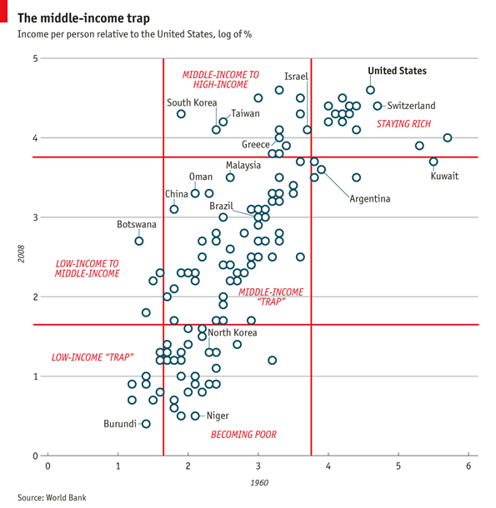
But sustaining growth into high income is difficult

Slide 12
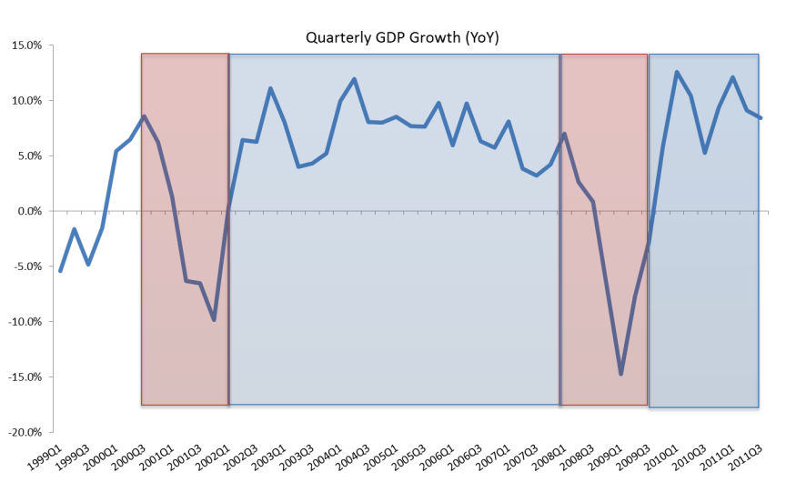
And growth in Turkey has been volatile given dependence on foreign financing

Slide 13
The middle income trap

Slide 14
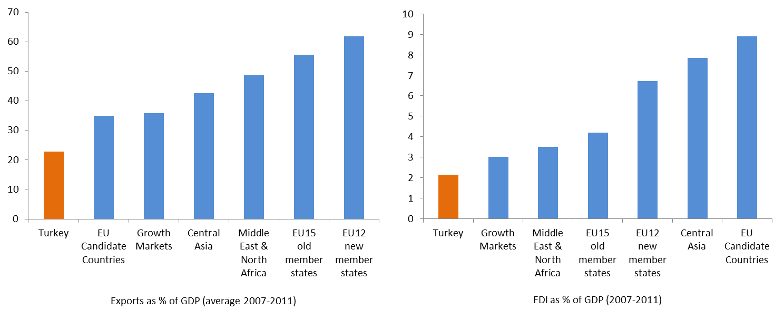
What Turkey needs to do to sustain growth: deepen integration

Slide 15
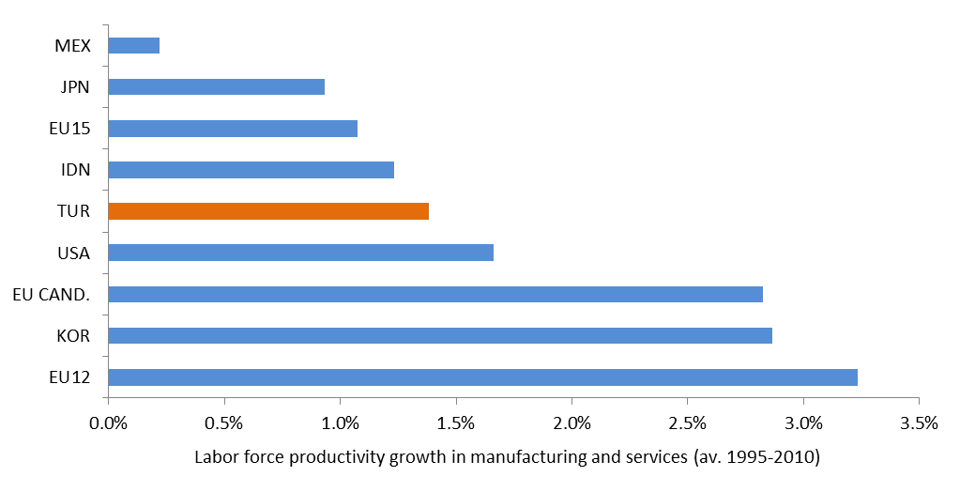
What Turkey needs to do to sustain growth: boost productivity

Slide 16
What Turkey needs to do to sustain growth: boost energy efficiency

Slide 17
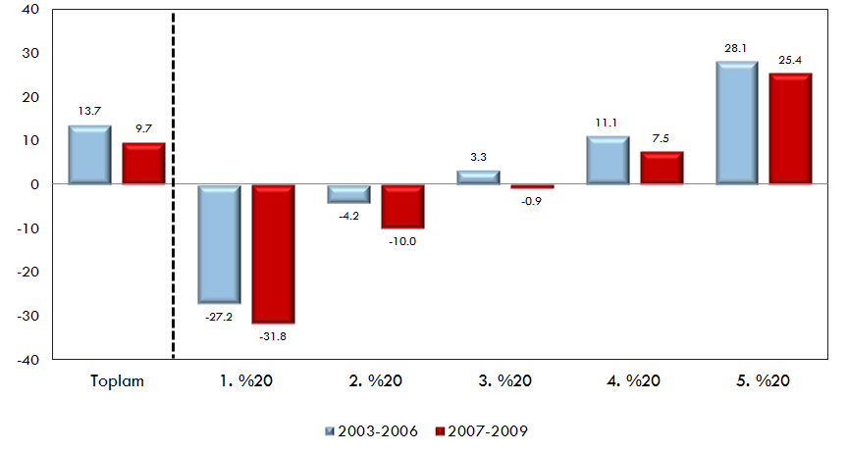
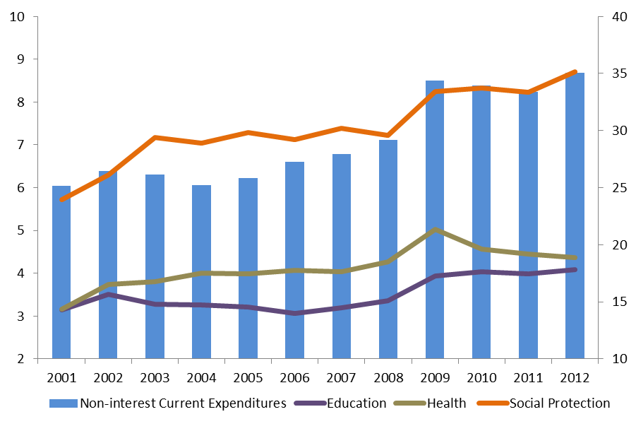
What Turkey needs to do to sustain growth: boost savings and contain growth in transfers

Slide 18
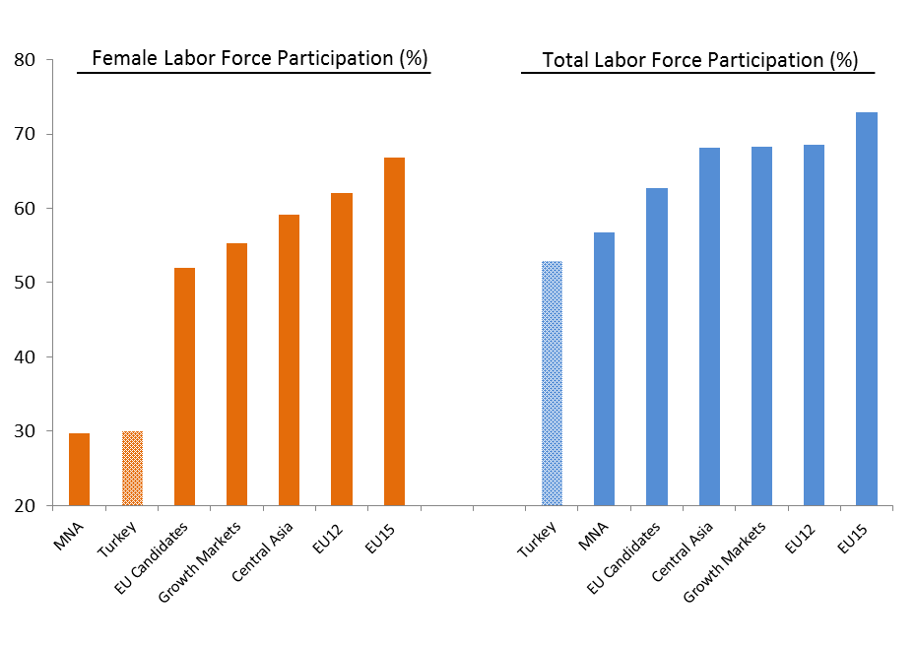
What Turkey needs to do to sustain growth: boost female employment

Slide 19
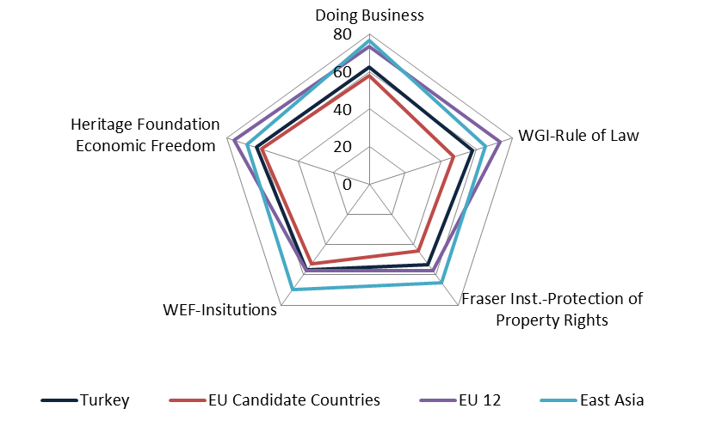
What Turkey needs to do to sustain growth: make institutions fit for high income

Slide 20
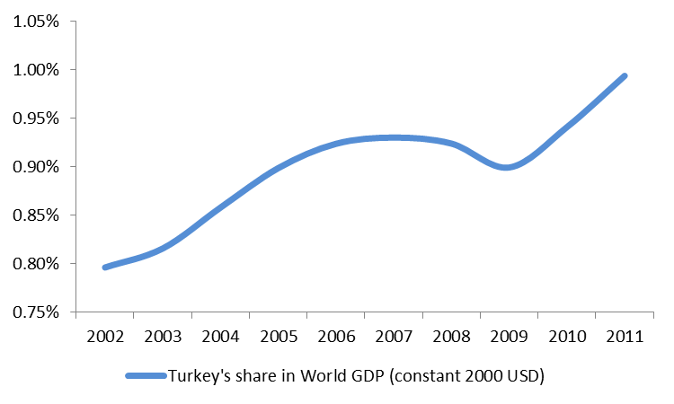
Turkey: an emerging regional and global power

Slide 21
Turkey: an emerging regional and global power
Total GDP in 2011 USD, 2011 and 2060)
The 20 largest economies in the world in 2011 and 2060 - OECD

